Slide 1
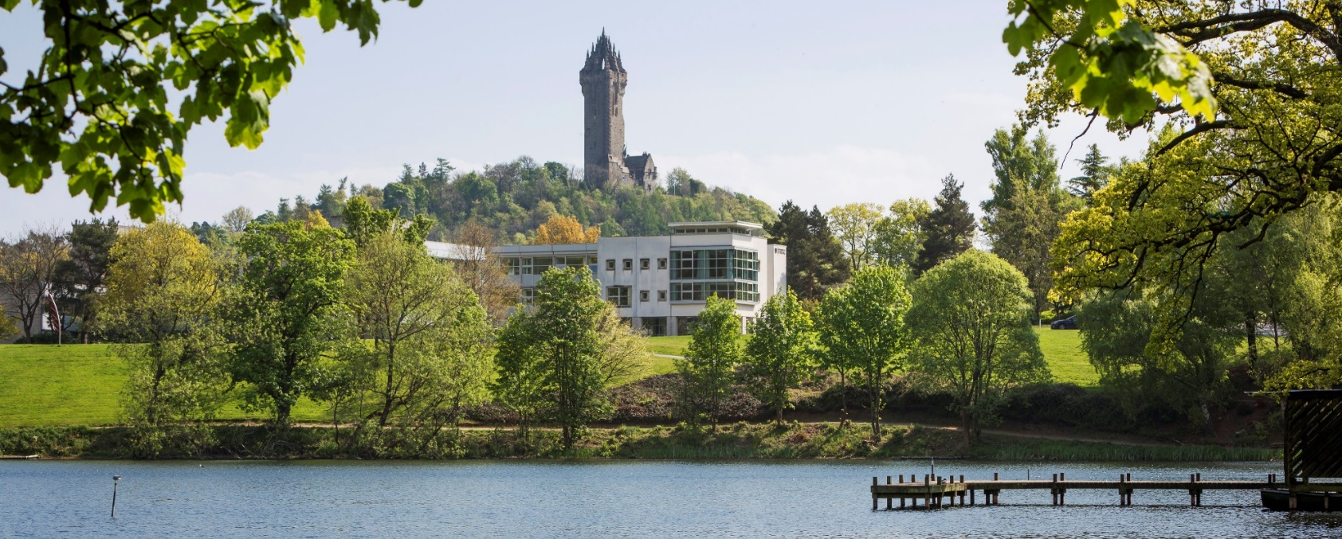
HAGIS Covid results – Expectations & intentions
David A. Comerford
Scottish Economics Society Conference 2022

Slide 2
Background
Directly, Covid-19 posed a threat to:
Own health
The health of loved ones and dependents
Capacity to work
Future income
Capacity to engage in leisure activities
Indirectly, the pandemic may have caused people to update their beliefs around e.g.
The vulnerability of society to catastrophic risk
The robustness of state institutions’ capacities to provide a safety net
Their own life expectancy etc.

Slide 3
Research questions
1. How are people feeling regarding their long-term financial prospects?
2. How and where do people intend spending their money?
3. How do people intend spending their time?
4. What effect did the pandemic have on subjective life expectancy?

Slide 4
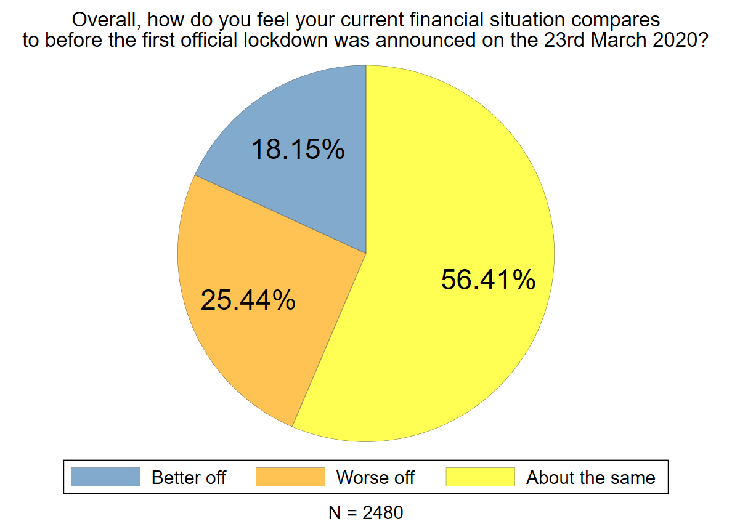
Current financial situation compared to before the first lockdown

Slide 5
Research Question 1. How are people feeling regarding their long-term financial prospects?
I feel uncertainty around my longer term financial position
**For Alan to graph in two graphs**
Graph 1. About 10% of those who report not being worse off agree with the above
Graph 2. About 43% of those who report being worse off agree with the above
Less educated respondents are no more likely to report being worse off (p = .726)
But
Less educated respondents are more likely to agree that they feel uncertainty around their longer term financial position (p = .003)

Slide 6
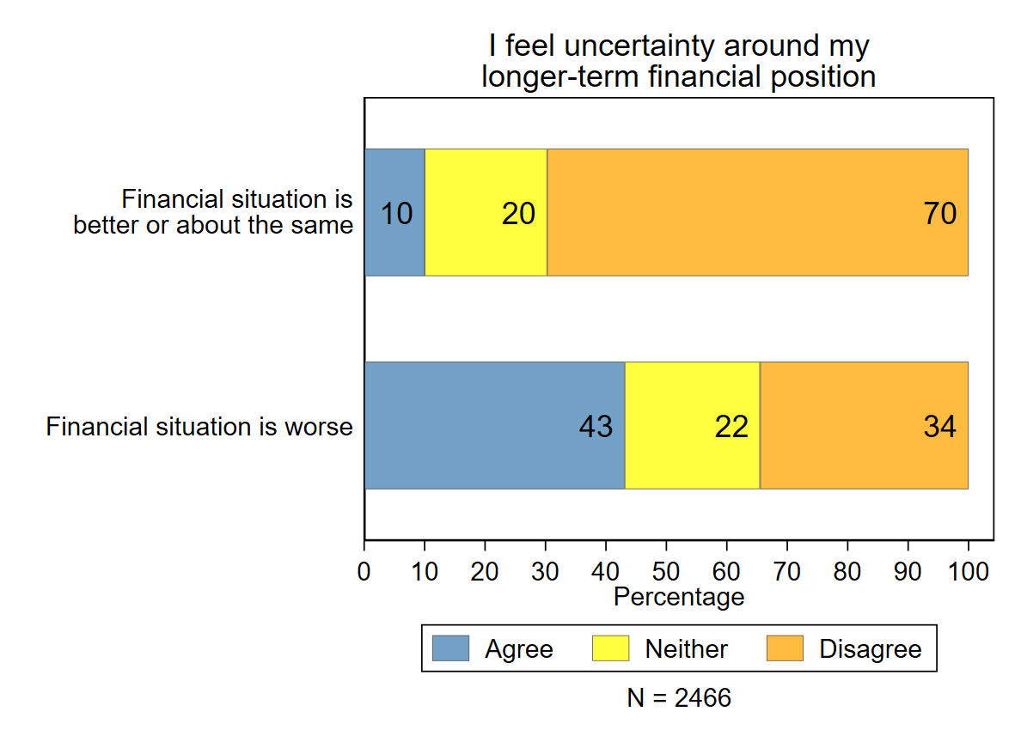
Research Question 1. How are people feeling regarding their long-term financial prospects? (1)
I feel uncertainty around my longer term financial position
Less educated respondents are no more likely to report being worse off (p = .726)
But
Less educated respondents are more likely to agree that they feel uncertainty around their longer term financial position (p = .003)

Slide 7
Research Question 2. How and where do people intend spending their money?

Slide 8
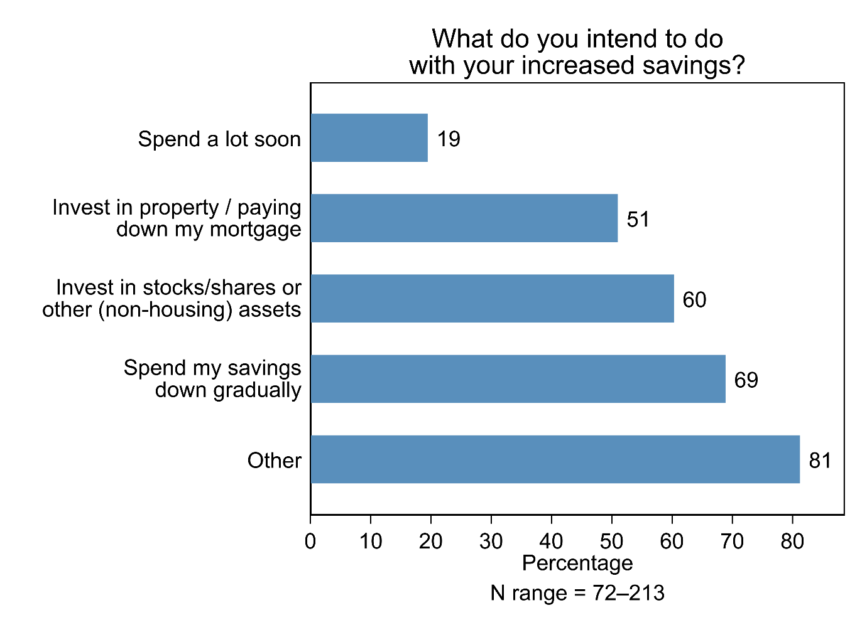
What do those better off intend doing with their savings?

Slide 9
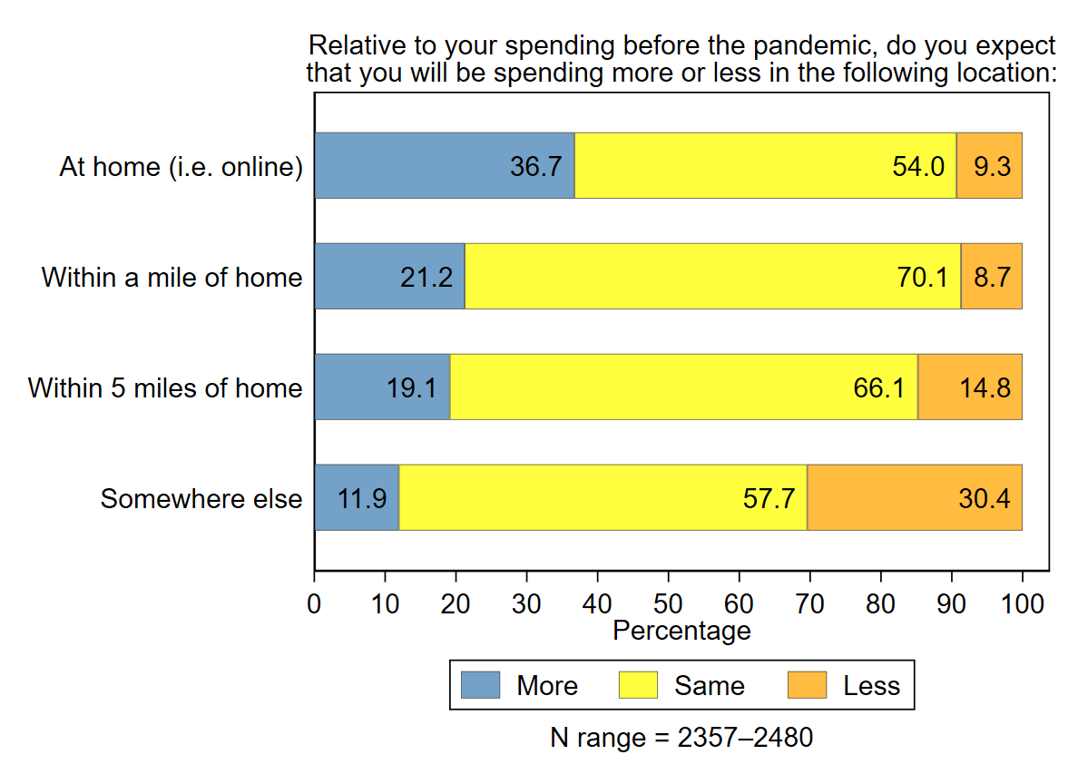
Expectations of spending in various locations

Slide 10
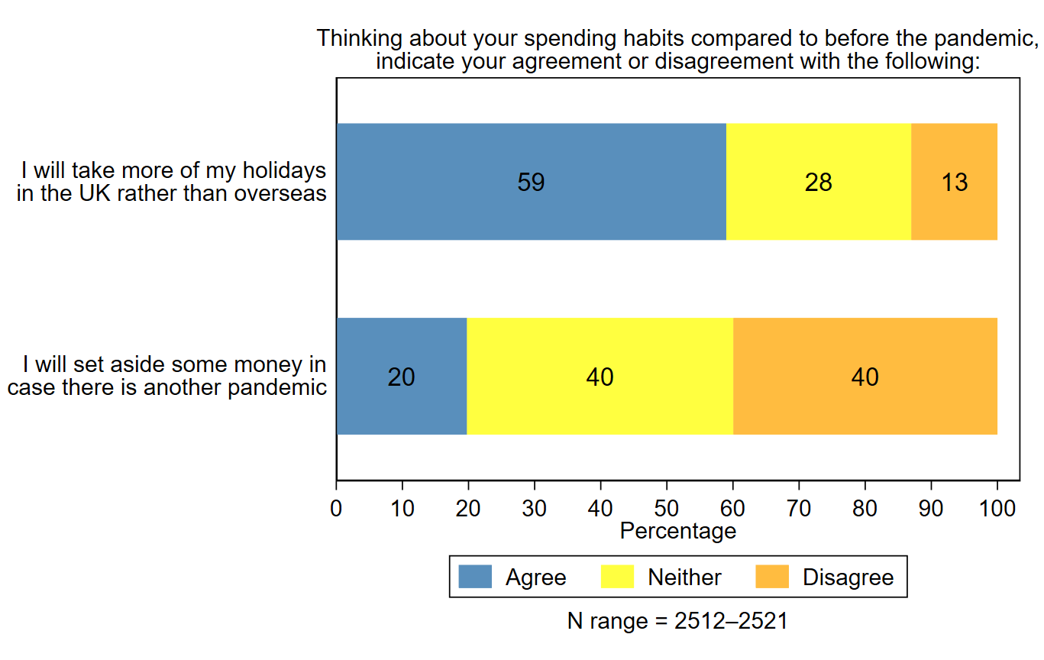
Spending habits compared to pre-pandemic
Less educated respondents are more likely to set aside money in case there is another pandemic (p < .001)
The education effect is somewhat, but not fully, explained by the fact that less educated respondents are more worried about their longer term financial position

Slide 11
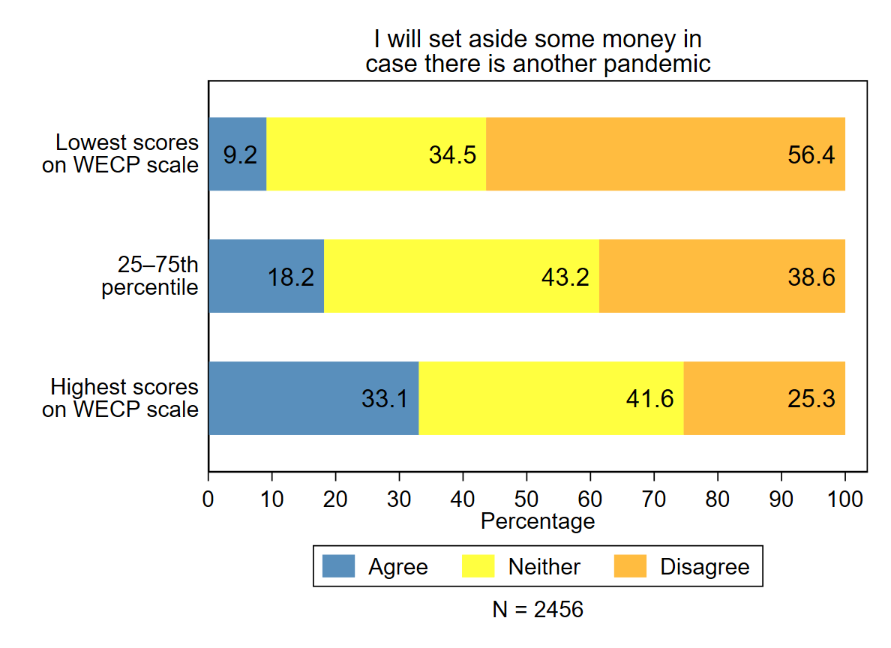
Saving patterns in case of another pandemic
This pattern holds even if we drop from the scale the two items that refer to financial worries (p < .001)

Slide 12
Research Question 3. How do people intend spending their time?

Slide 13
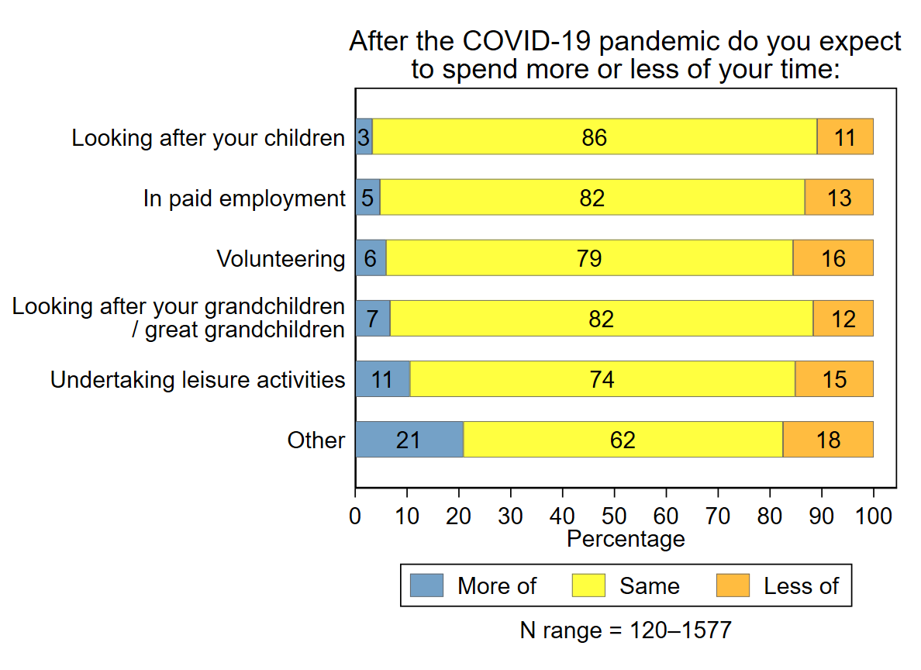
Expectations of spending time in various activities after COVID-19

Slide 14
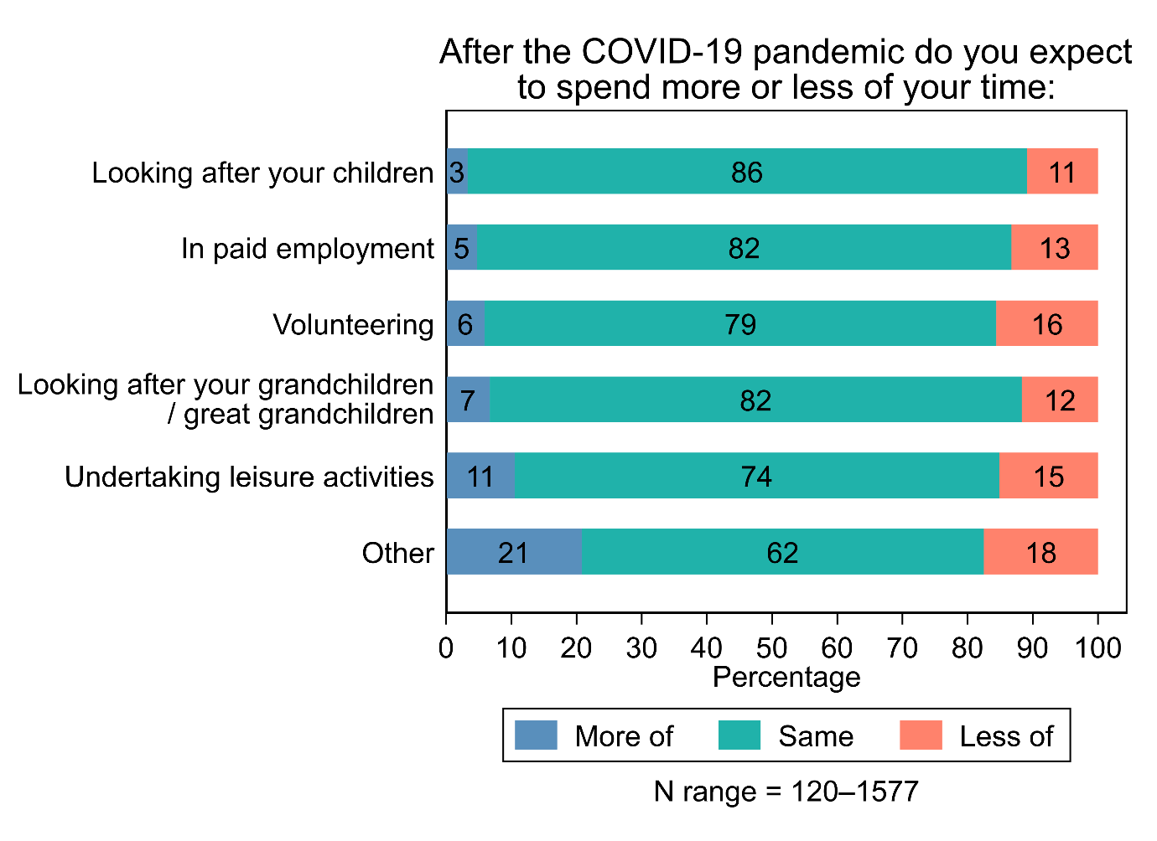
Other: Meeting people Studying Travelling Caregiving

Slide 15
Research Question 4. Have people updated their life expectancy beliefs?

Slide 16
Life expectancy beliefs
 | Covid Wave (2021; n = 3375)
Own LE | 83.7 years
Others’ LE | 81.4 years

Slide 17
Life expectancy beliefs (1)
 | Did not have Covid (2021; n = 2999) | Had Covid (2021; n = 248)
Own LE | 83.7 years | 82.7 years
Others’ LE | 81.5 years | 81.1 years

Slide 18
Life expectancy beliefs Unweighted – sample characteristics may differ across Wave 1 and Covid Wave
 | Wave 1 (2016-17; n = 679) | Covid Wave (2021; n = 3375)
Own LE | 82.6 years | 83.7 years
Others’ LE | 81.9 years | 81.4 years

Slide 19
Life expectancy beliefs (2)
 | Wave 1 (2016-17; n = 679)* | Covid Wave (2021; n = 3375)* | Longitudinal (n = 82)
Own LE | 82.6 years | 83.7 years | +1.95 years
Others’ LE | 81.9 years | 81.4 years | +1.2 years
* P < .001, Controlling for age, gender, marital status and education

Slide 20
Summary
Our less educated respondents are more likely to worry about their longterm financial position.
There is a slight tendency towards withdrawal from consumption post-COVID pandemic
Intentions to consume at home and more locally (e.g. holidays)
Intentions to spend less time on out-of-home activities
Intentions to save against risk of a future pandemic
There is no indication that people have become more pessimistic regarding their life expectancy

Slide 21
david.comerford@stir.ac.uk

